Slide 1






Hospital Patient Management System
A Lightweight, C-Based Patient Record Management & Automated Billing Solution
PROJECT TEAM

Slide 2
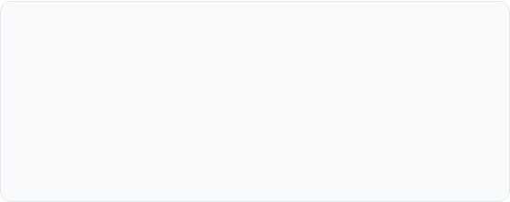
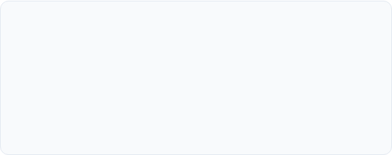
Project Team & Responsibilities
Core Development Team
Analysis & Quality Team
Naren Karthick G & Madhan Kumar Y
Grascy Jennifer J R & Keerthika B
Engineered core data structures (`struct Patient`), file handling persistence (`patients.txt`), memory allocation, and module integration for CLI operations.
Designed the automated billing calculation engine, temp-file updating protocols, user validation routines, and system test scenarios.

Slide 3


Project Abstract
Digital Recordkeeping: Replaces manual paper-based hospital registers with an efficient C console application.
Data Persistence: Utilizes file I/O operations to securely store, retrieve, and update patient data across sessions.
Automated Financials: Computes room stay charges and medication expenses with instant automated bill generation.
High Efficiency: Operates lightweight text file processing for fast search and updates without external database overhead.

Slide 4







Key Features Overview
Patient Admission
Quick Search
Dynamic Updates
Instant Billing
Captures Patient ID, Name, Age, Disease, Room Number, Days Admitted, Daily Charges, and Medication Costs.
Retrieves specific patient information instantly using unique Patient ID scanning over persistent records.
Updates existing patient files seamlessly using file staging (`temp.txt`) to preserve data integrity.
Calculates total stays and medication expenses into a clean, formatted digital billing receipt.

Slide 5

System Architecture
Structured C Implementation
The system is built upon a modular execution model written in standard C programming language.
It leverages composite data structures (`struct`) to represent patient entities and standard C libraries (`stdio.h`, `stdlib.h`, `string.h`) for memory and file manipulation.
File handling operations (`fopen`, `fprintf`, `fscanf`) are used to persist records in plain text format (`patients.txt`).

Slide 6
Core Code Modules
addPatient(): Opens `patients.txt` in append mode (`"a"`) and logs new struct record entries seamlessly.
displayPatients(): Reads stored data sequentially (`"r"`) using `fscanf` and outputs a clean tabular summary.
searchPatient(): Filters file entries by user-specified ID and renders comprehensive patient detail cards.
updatePatient(): Writes updated data to `temp.txt` and renames it to replace original records safely.
generateBill(): Computes `(days × dailyRate) + medicineCost` dynamically to output total billing summaries.

Slide 7

Sample Patient Dataset
ID | Patient Name | Age | Disease | Room No. | Days | Daily Rate | Med. Cost
1 | Ram | 45 | Diabetes | 304 | 4 | ₹2,120.00 | ₹2,210.00
2 | Sam | 35 | Heart Disease | 305 | 2 | ₹1,150.00 | ₹2,450.00

Slide 8


Automated Billing Logic
Financial Calculation Formula
The total bill amount for any admitted patient is calculated using the following mathematical formulation:
100%
BILL COMPUTATION FORMULA:
Automated Computation
Example (Ram - ID 1): (4 days × ₹2,120.00) + ₹2,210.00 = ₹10,690.00 Total

Slide 9
Technical Advantages
Zero-Dependency Persistence
Atomic File Updates
No requirement for external database drivers (e.g., MySQL, SQLite). Runs on pure C file stream mechanisms, making it portable and easy to run on any compiler environment.
Prevents file corruption during update procedures by staging temporary entries into `temp.txt` before executing atomic `remove()` and `rename()` C file operations.

Slide 10
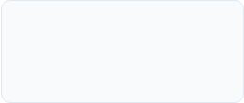
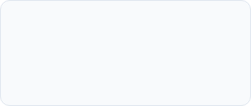
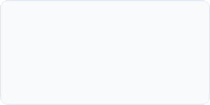
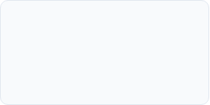
Development Roadmap
Phase 2
Phase 4
File I/O programming (Add, Search, Display records).
System testing, sample dataset verification & optimization.
Phase 1
Phase 3
Requirements gathering & data structure definition (`struct Patient`).
Update routine (`temp.txt`) & automated billing engine development.

Slide 11
Thank You!
Hospital Patient Management System in C
Naren Karthick G | Madhan Kumar Y | Grascy Jennifer J R | Keerthika B

Slide 12


Image Sources
https://media.easy-peasy.ai/49d0625e-396e-480c-a4ed-859d1ca32a5a/96f651e1-aeeb-40fe-bde9-a1e784584c71_medium.webp
Source: easy-peasy.ai
https://d2nzy1qhita6w.cloudfront.net/media/magefan_blog/Beginner-learning-C-programming-in-10-days-with-a-coding_guide.jpeg
Source: www.quickstart.com

